Slide 1

The Quiet Strides of a Colossus:
Igwe Vincent Onyekelu Ilo
1933-2016

Slide 2
_{Quotes from Igwe Vincent}
Never go a day without having someone tell you THANK YOU
Nobody grows poor from helping people
Always pray against the spirit of pride
Never say you can’t, always say ‘Let me try’

Slide 3
_{Quotes from Igwe Vincent}
God has never disappointed me
I have nothing else to offer but prayers
Always be consistent with your time for prayers so God will wait for you when you pray

Slide 4
_{Quotes from Igwe Vincent}
Always remember the family that you are from
Pray pray and always pray
Be kind to everybody you encounter
Never give up on people

Slide 5
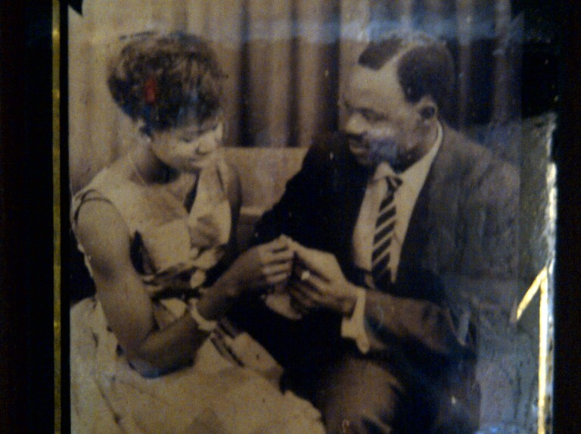

The Romantic Daddy

Slide 6
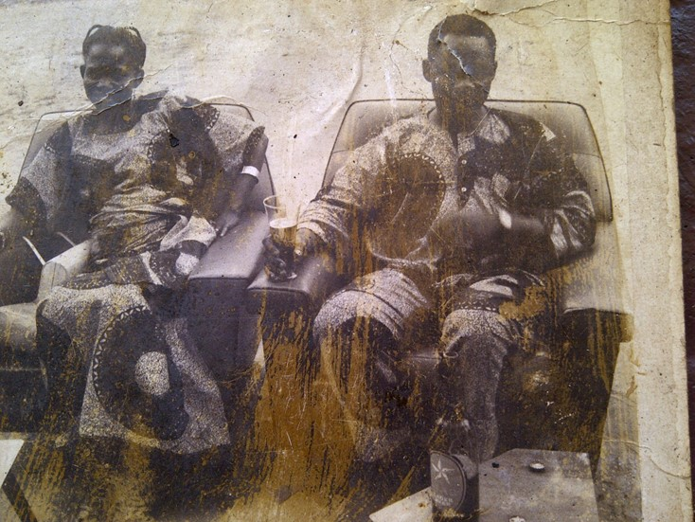
Love in………

Slide 7
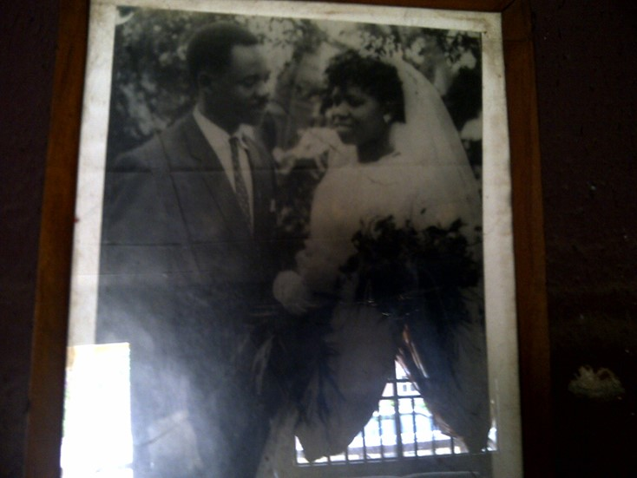
Till death do us part……

Slide 8
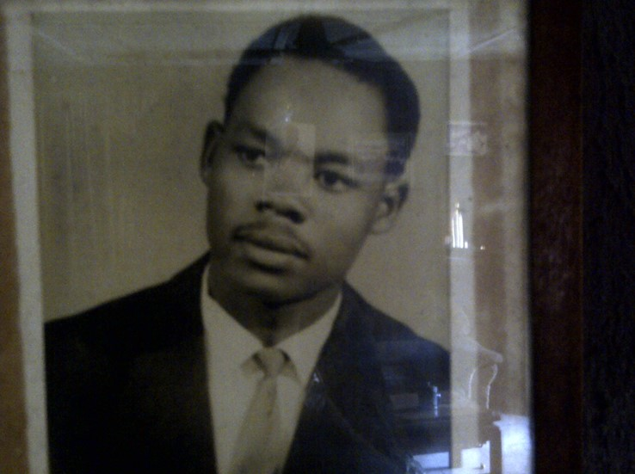
You cant beat this…..

Slide 9
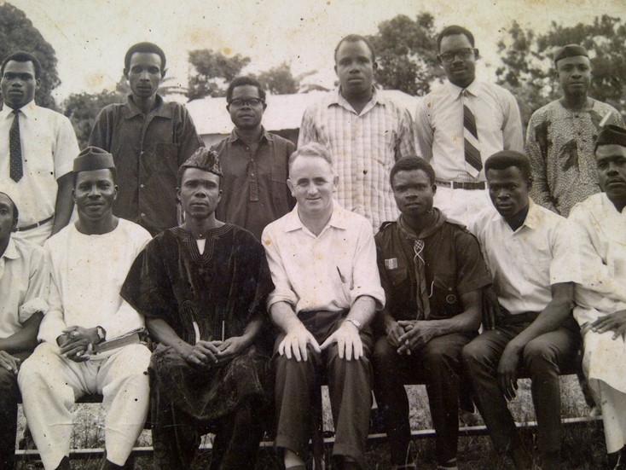
Second from right standing- early days of being a man

Slide 10
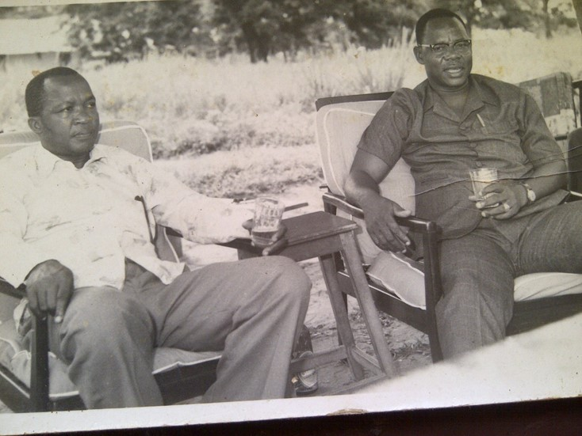
A glass or two-

Slide 11
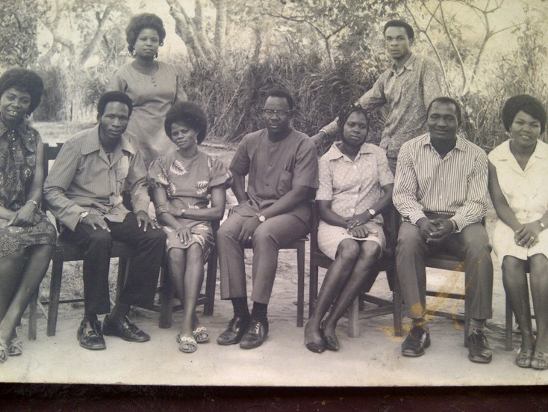
See who is beside daddy- wonder how they concentrated at work

Slide 12
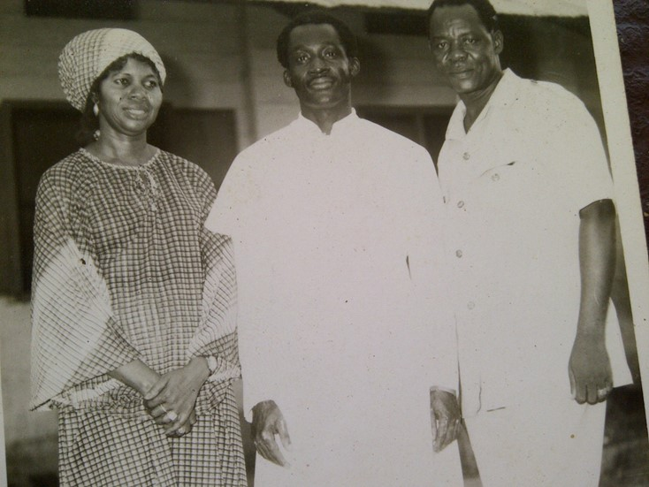
Never far from the faith

Slide 13
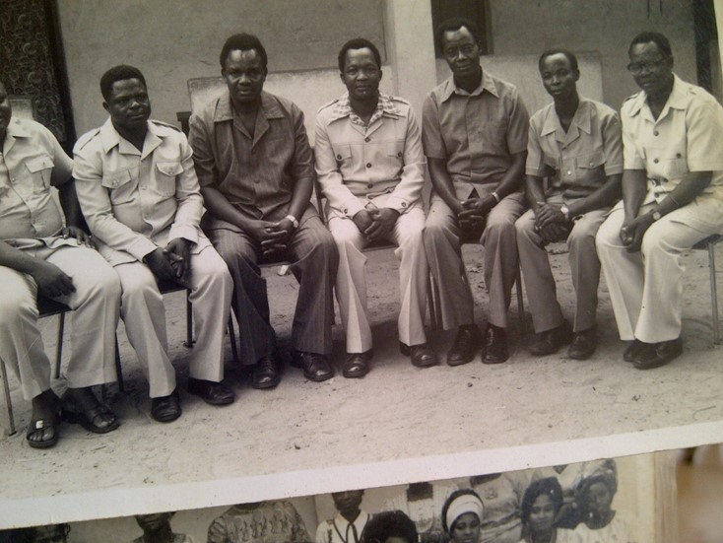
St Charles Old Boys– End of a generation

Slide 14
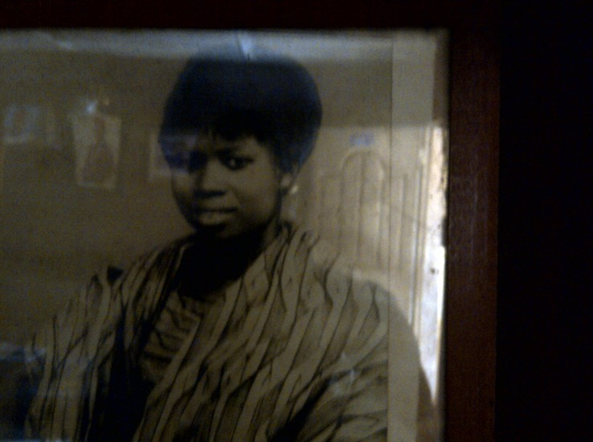
The Apple of Igwe’s eyes

Slide 15
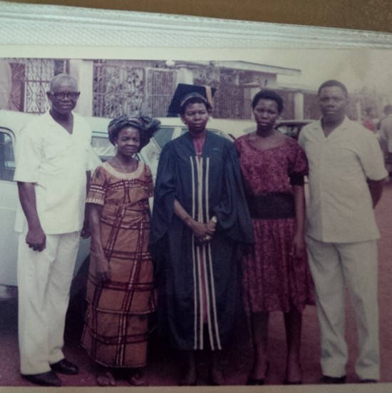
Proud Husband

Slide 16
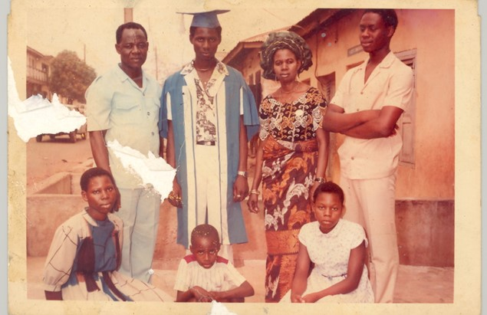
Proud father

Slide 17
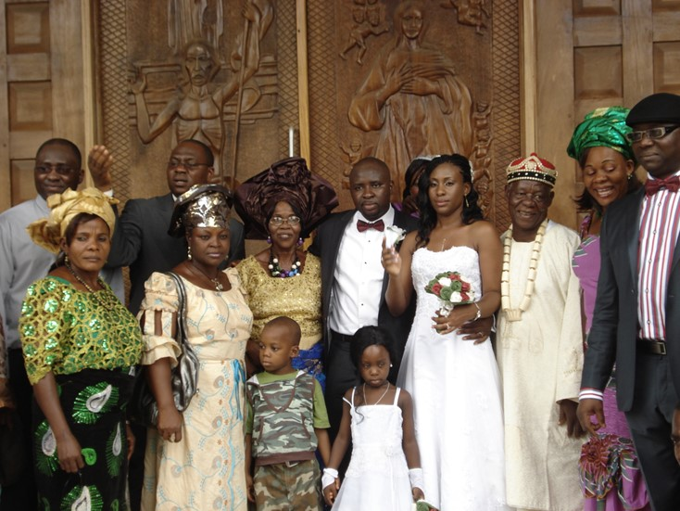
Proud father

Slide 18
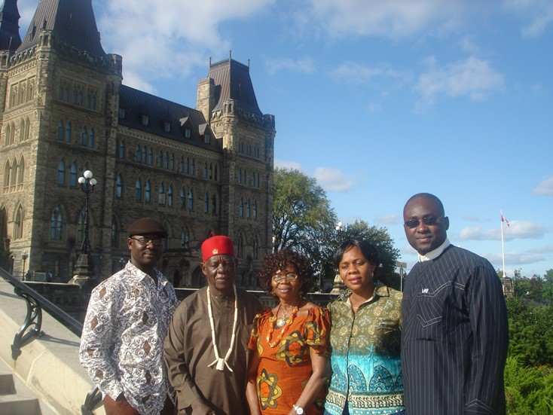
Proud father

Slide 19
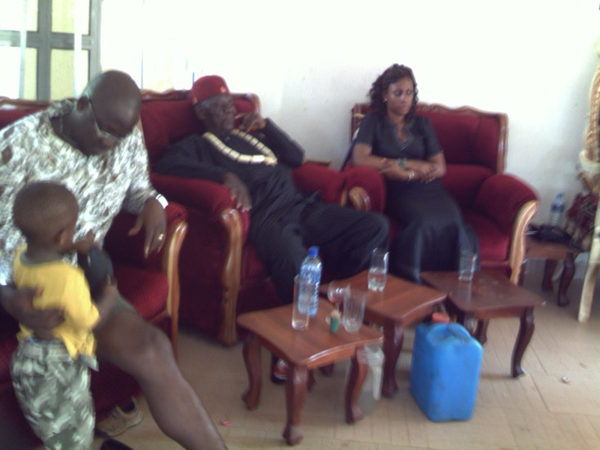
Proud father

Slide 20
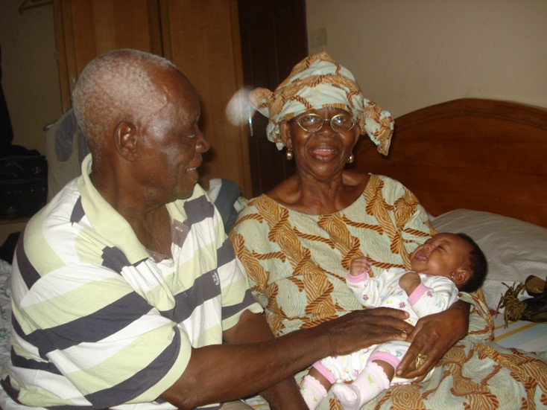
The Orphan who became a grand dad

Slide 21
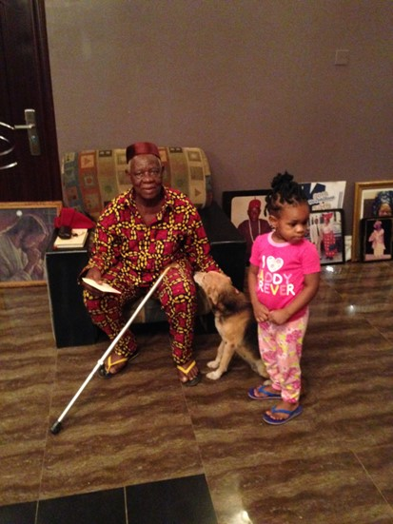
Grand Pa

Slide 22
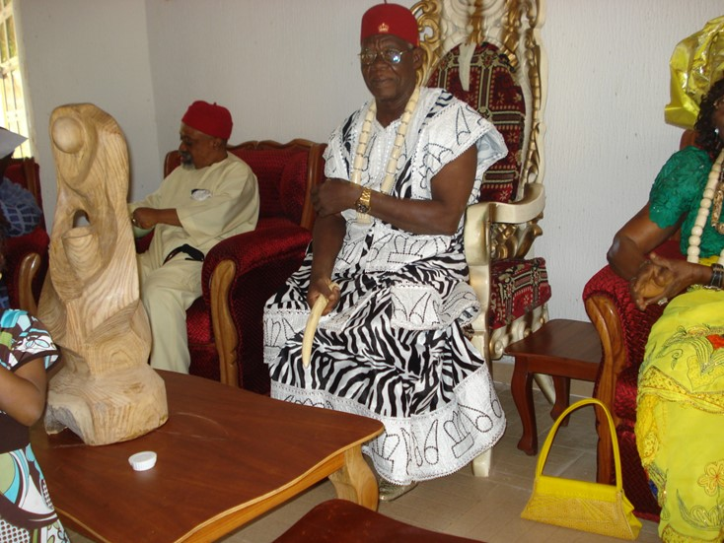
The Orphan who became a King

Slide 23
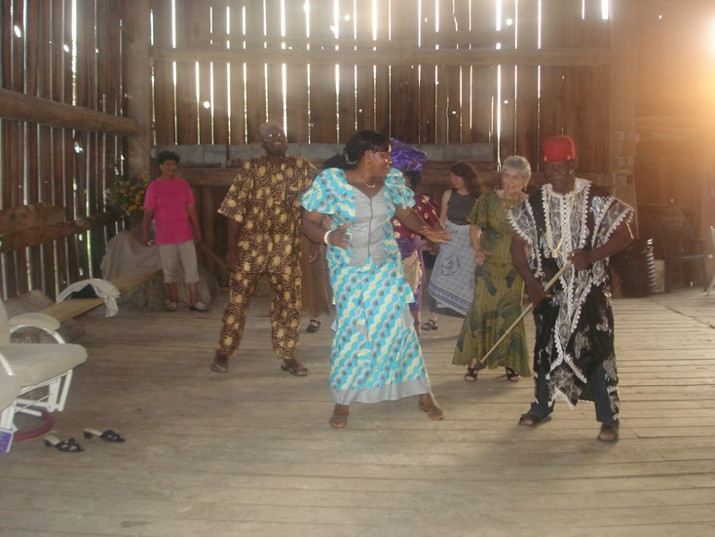
And he can really dance

Slide 24
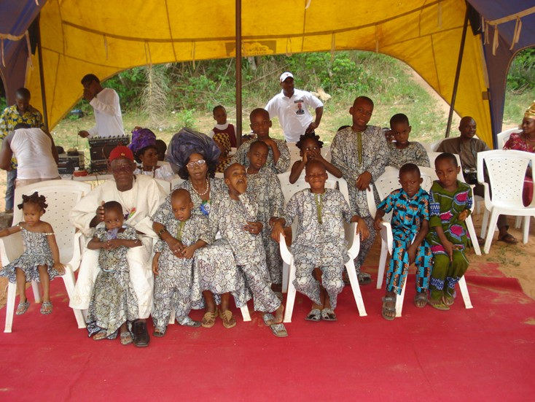
Grands

Slide 25
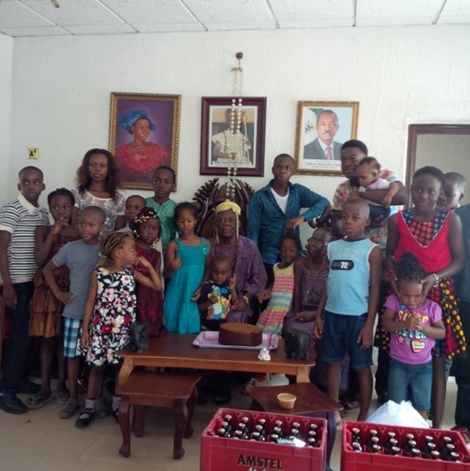
Grands

Slide 26
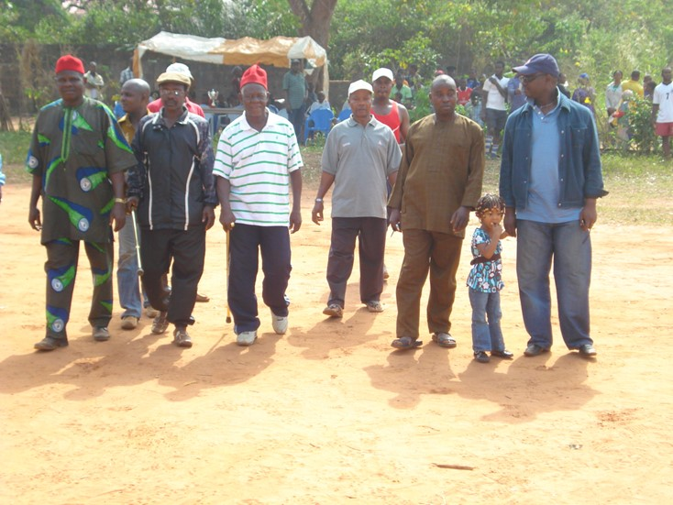
Being King

Slide 27
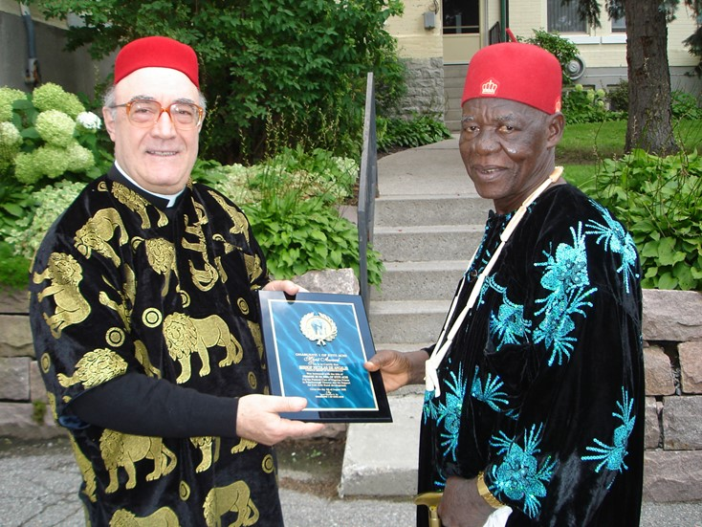
Kingly Function

Slide 28
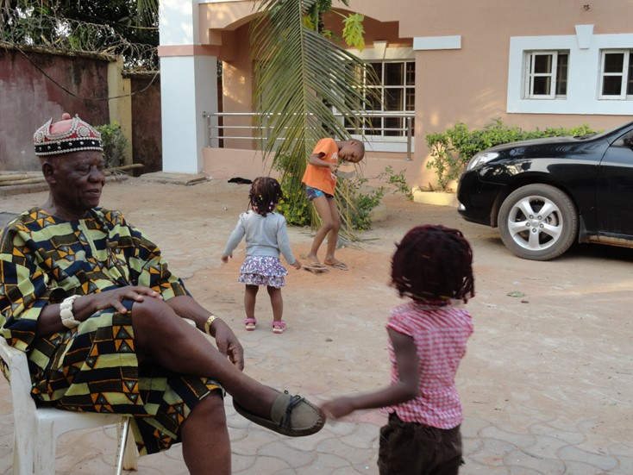
Grand Daddy Functions

Slide 29
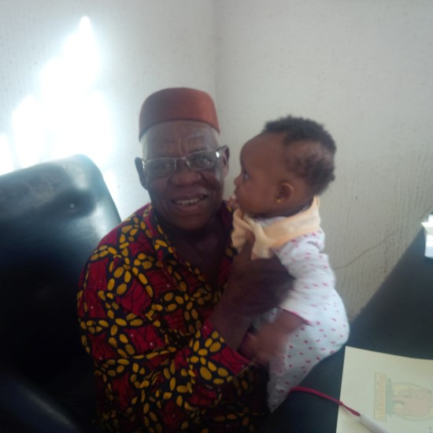
Grand Daddy Functions

Slide 30
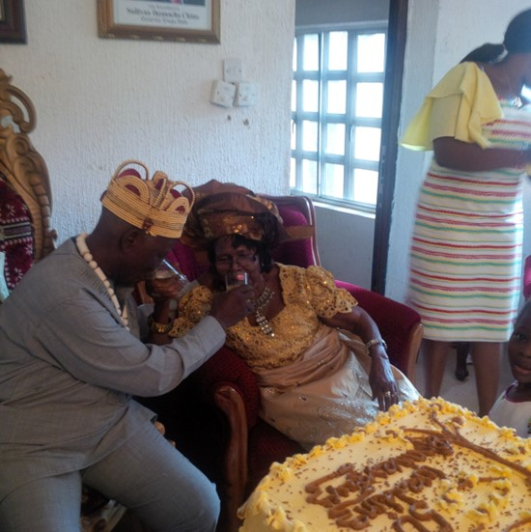
Lover Boy…..

Slide 31
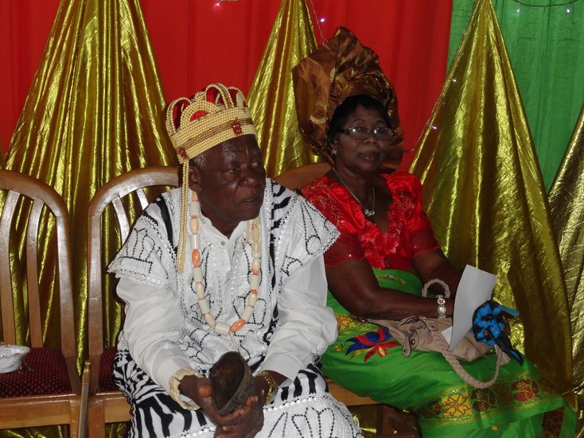
Listening Igwe

Slide 32
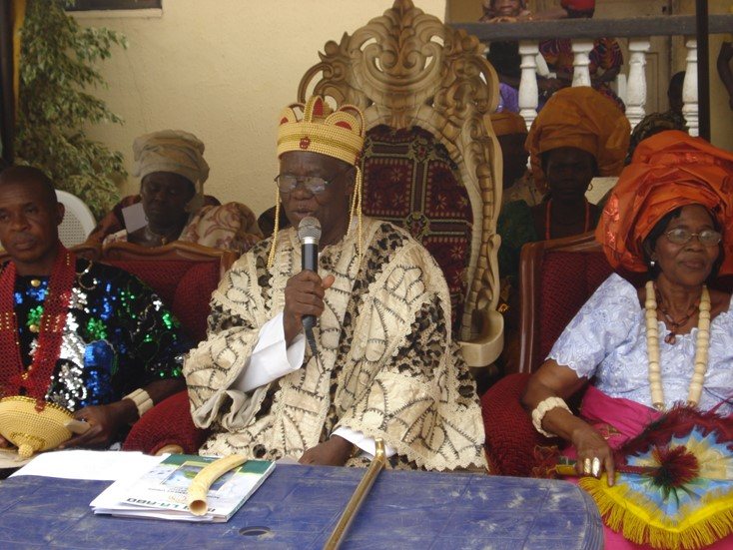
Ohabuenyi

Slide 33
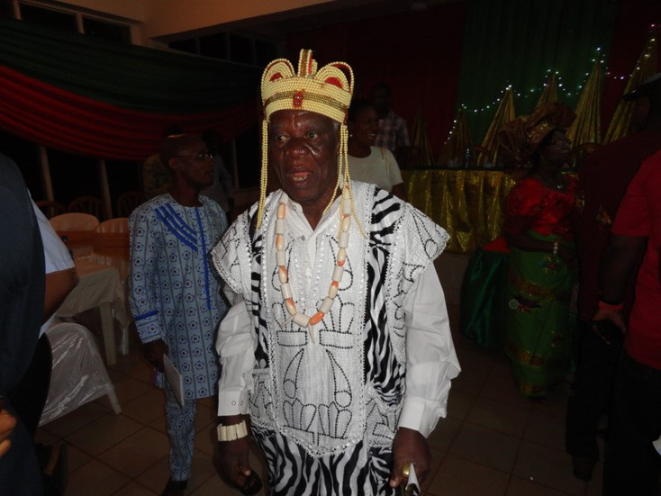
Igweeeeee

Slide 34
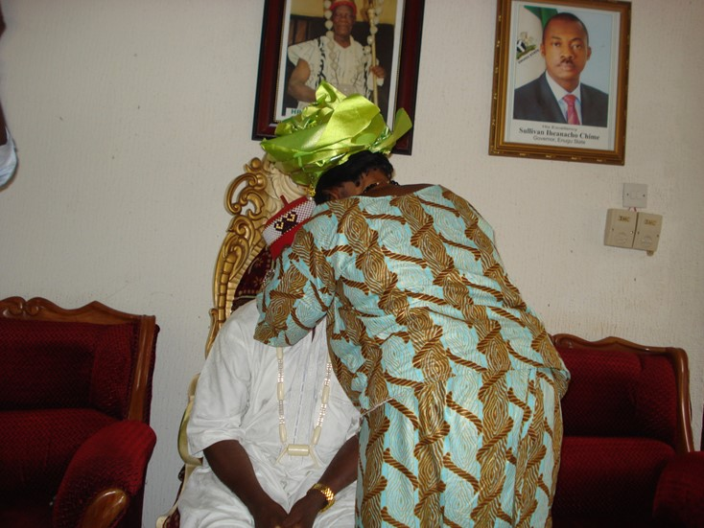
Romeo and Juliet

Slide 35
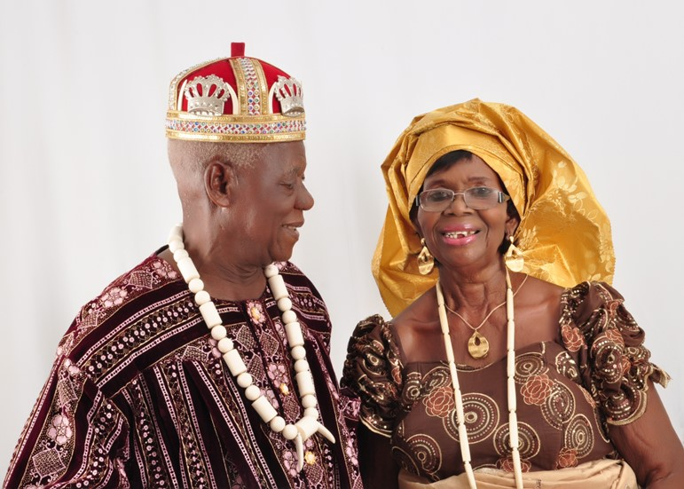
Lover boy

Slide 36
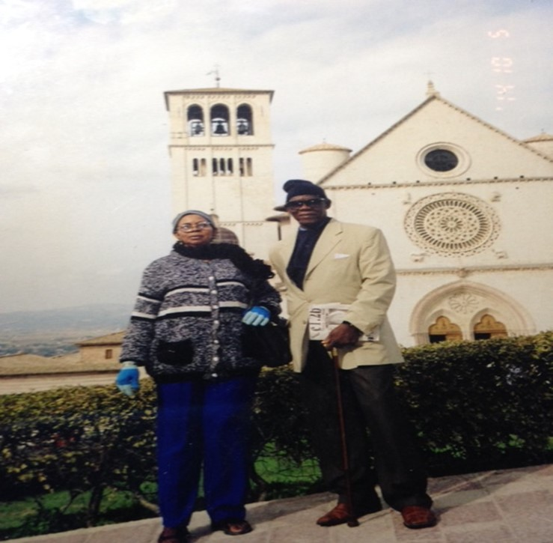
Romeo and Juliet

Slide 37
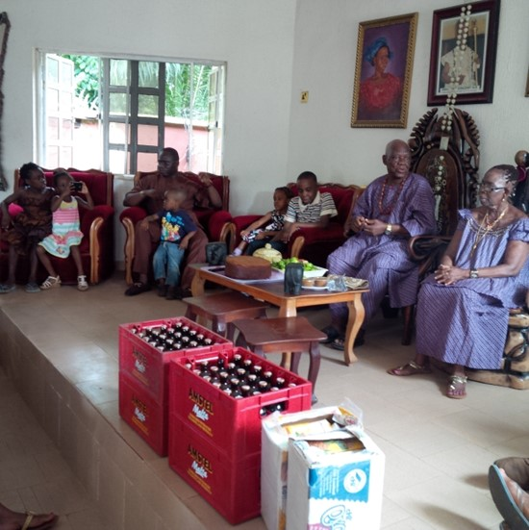
Romeo and Juliet

Slide 38
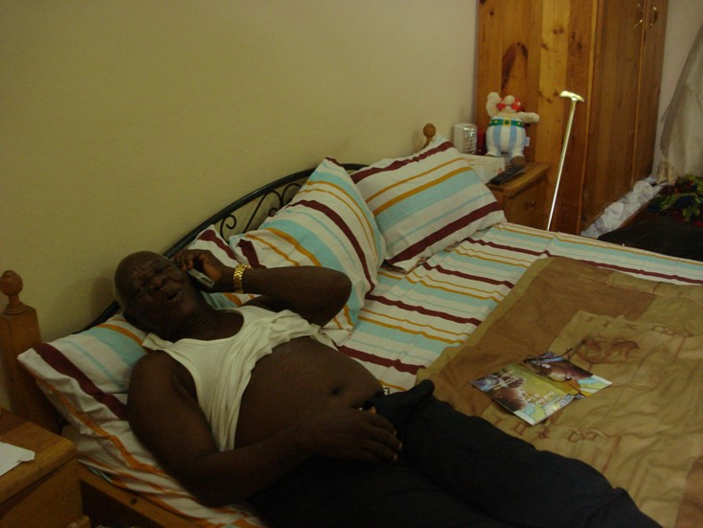
Simple ways and topless pose

Slide 39
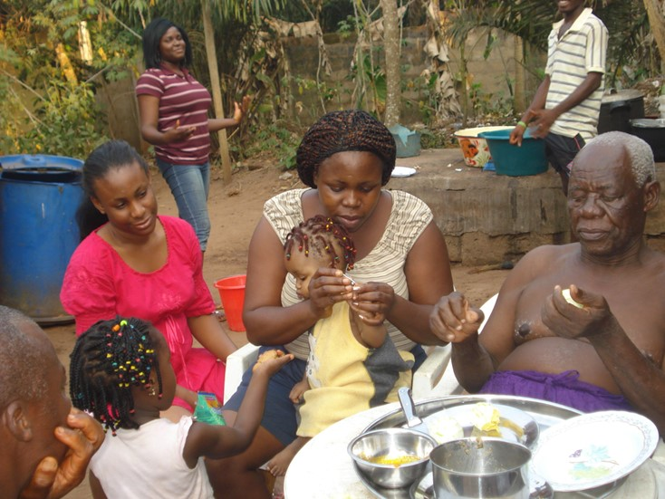
Topless pose

Slide 40
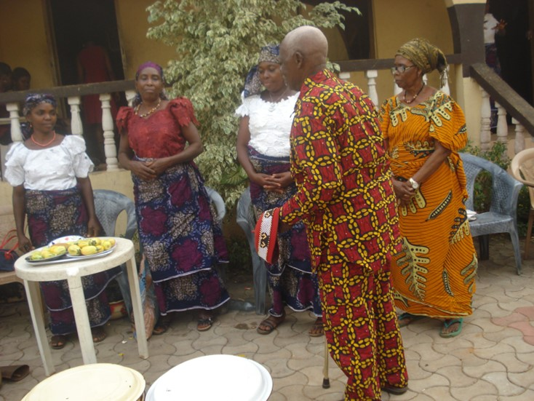
Prayer Prayer Prayer

Slide 41
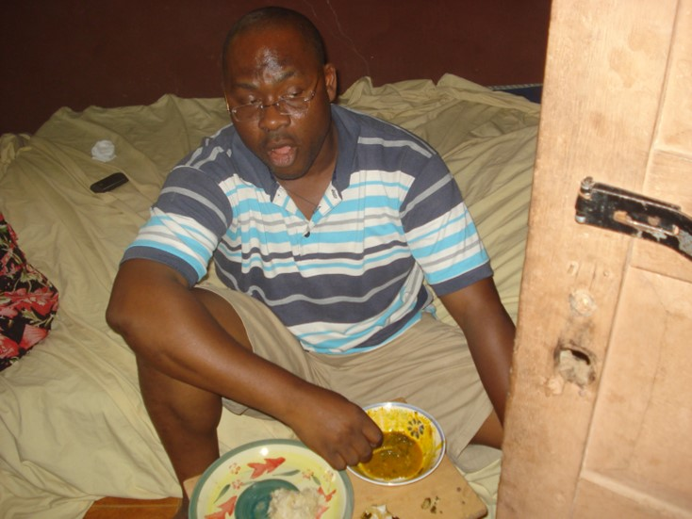
He wasn’t talking to Daddy!!

Slide 42
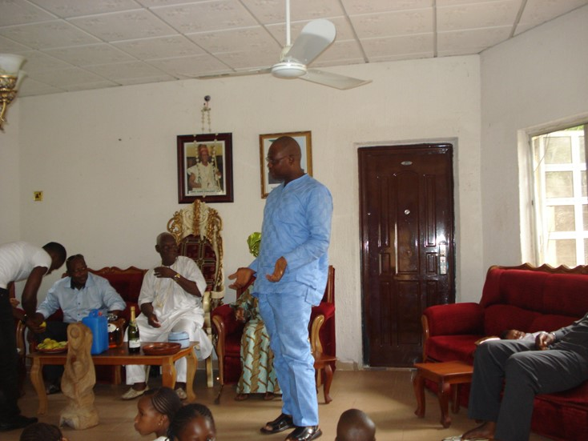
Now he is talking to daddy

Slide 43
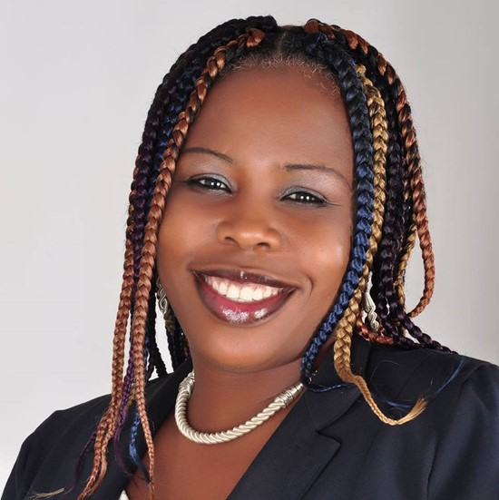
He got taste like his father

Slide 44
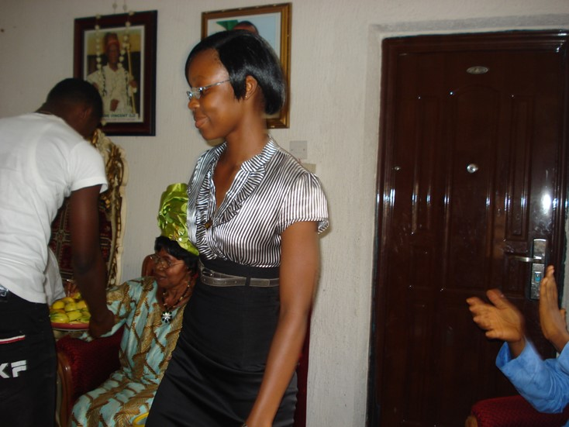
The grand that didn’t deliver on you know what!!!!!

Slide 45
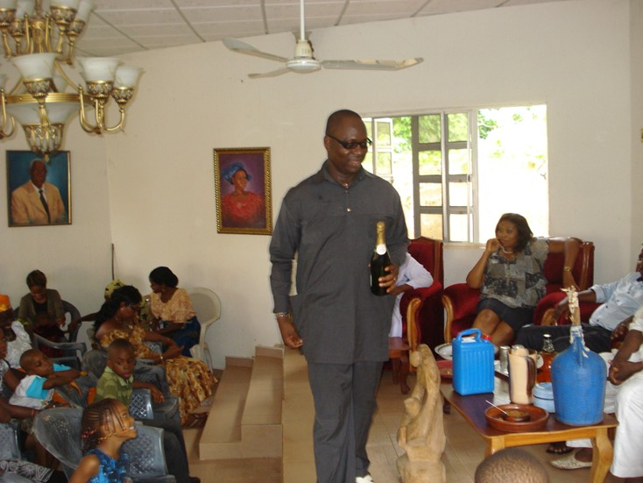
The prince who doesn’t want to be --- you know…….

Slide 46
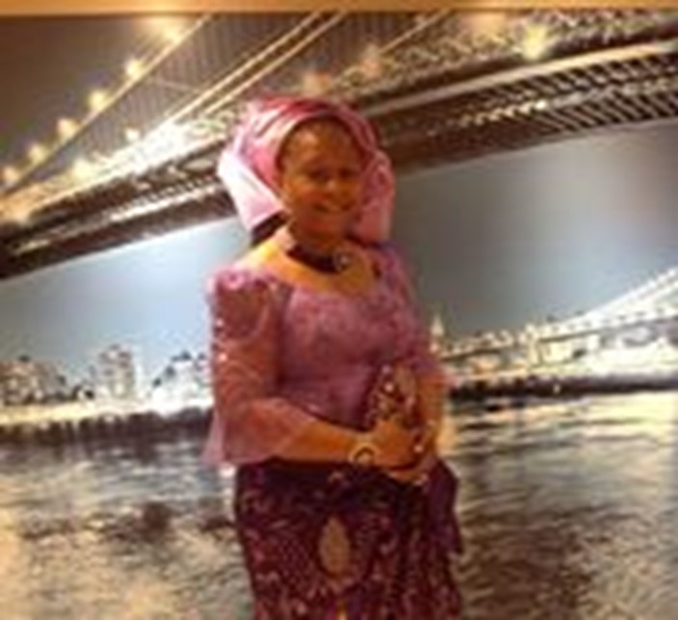
And just like his father… You cant touch this

Slide 47
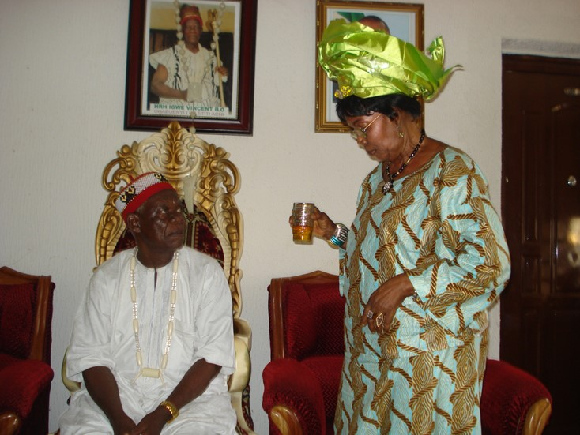
The one that makes his heart flicker

Slide 48
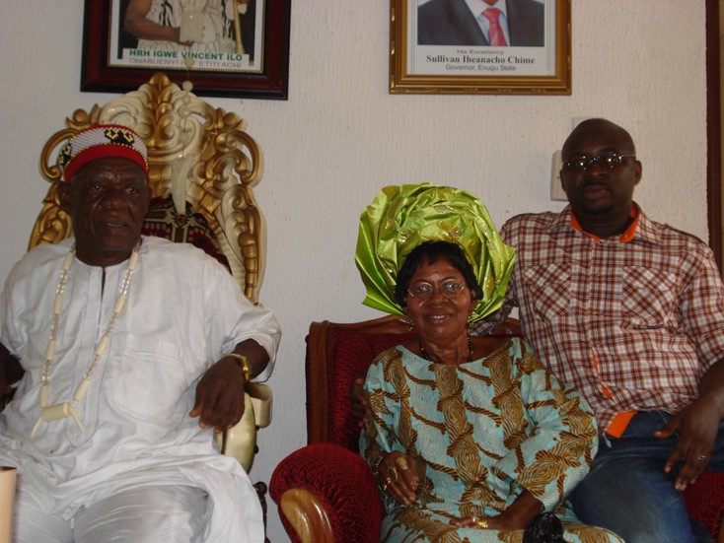
You aren't last born no more

Slide 49
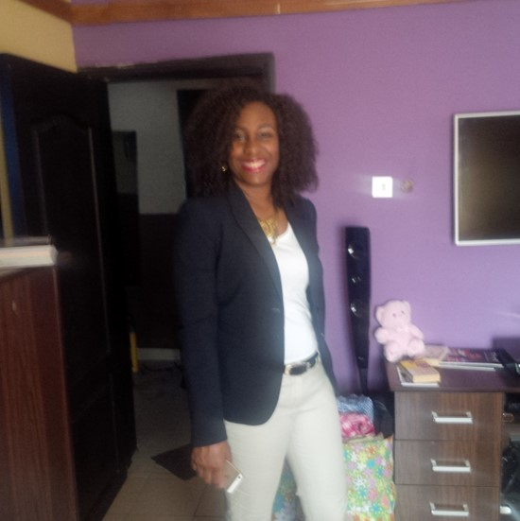
And the last one (as he then was) got game too

Slide 50
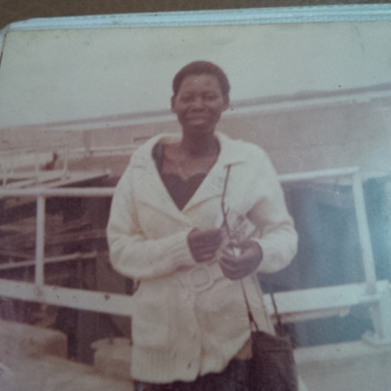
Daddy’s favorite!!!!! Well it was never resolved

Slide 51
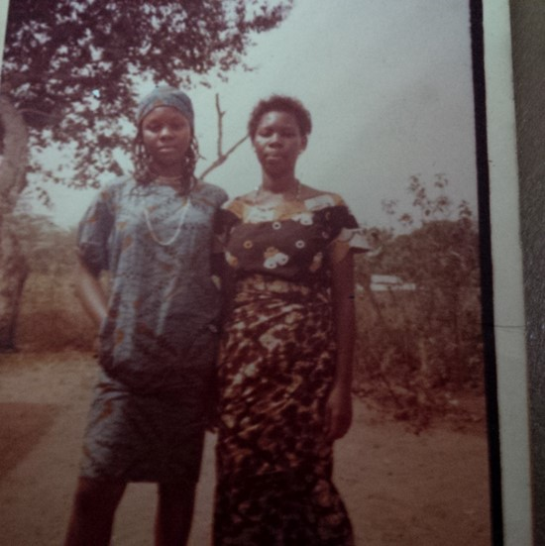
Daddy’s little girls, as they then were

Slide 52
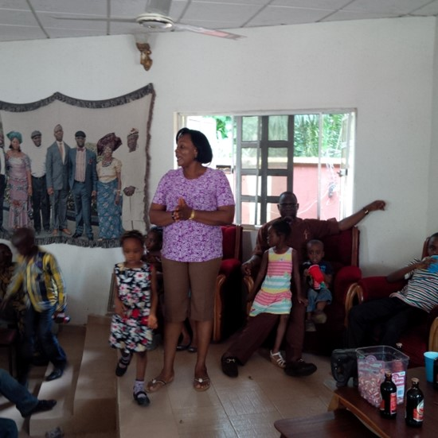
The one who runs the house

Slide 53
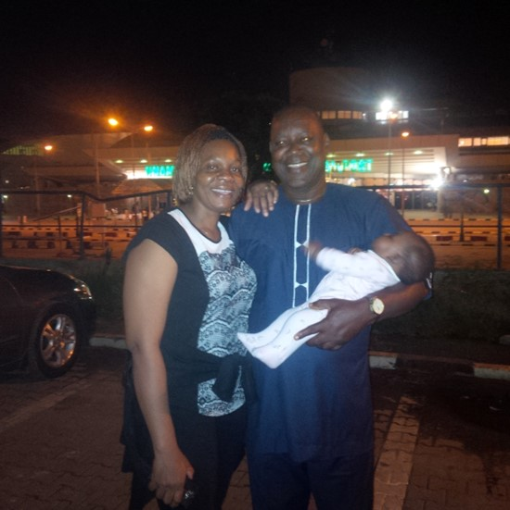
And she got her own rock- Ezieanya

Slide 54
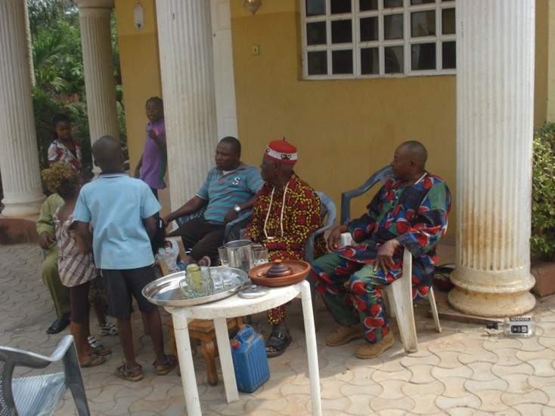
The people’s Igwe

Slide 55

Last xmass-2015

Slide 56

And the angels came calling

Slide 57

Tributes and Testimonies

Slide 58

Tributes

Slide 59

So much love

Slide 60

So much love

Slide 61

So much love

Slide 62

So much love

Slide 63
Daddy in heaven

Slide 64

Daddy in the world wide web

Slide 65

Tributes

Slide 66
And the kind words kept coming

Slide 67

And the kind words kept coming

Slide 68

And the little ones wrote too

Slide 69

More words

Slide 70

Tribute

Slide 71

More words

Slide 72

We love you Daddy so very very much

